Slide 1

Module 9:
Refuting
Non-Christian
Monotheism

Slide 2
How do we refute non-Christian monotheism?
The same way we do the others
The same 4 principles
we use for reasoning with unbelievers...

Slide 3

Problems to lookout for
1.) Opinions
and Self-Contradictions
2.) Unargued, privileged beliefs
3.) Sibling Rivalry
4.) Stealing from God

Slide 4





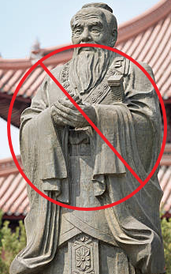

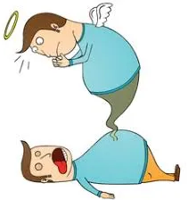

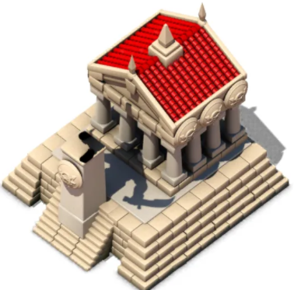





Review – 4 Worldviews
Materialist
A spiritual oneness
Dualist
Polytheism
Monotheism
Notes:
Why won't these work?
1.)Atomism: time + chance, acting on matter.
Atoms can't be universal, constantly change.
Logic is universal and unchanging.
Atoms insufficient as source of moralsm, choice, and logic.
We all hold others to moral standards. No one lives as if atheism is true.
2.)Confucious say? That's his opinion.
The Christian God knows everything. He doesn't
3.)Multiple gods means competing sources of authority, destroying the possibility of unchanging universals such as logic or truth in morality.
Also, how was it revealed?
Able to create life and the universe?
4.)The other Abrahamic religions depend on Christianity and contradict on their own standards.
-Others: can their deity support universals? Creation? Human nature, value

Slide 5
Monotheism
Is one god
-who created everything
-and chose to reveal himself

Slide 6



Religious Revelation
We know because “God” told us so.
Mormons, Islam, Judaism
How do you deal with these?
Is it a stalemate?
No, you treat them Biblically.
Why?
Because all of them are committed to the Bible
and contradict God's previous
revelation
Notes:
We are challenging coherence,
whether the other religions contradict themselves.
Why do we reject POVs that contradict themselves by their own standards?
-Because you aren't being rational if you constantly contradict yourself with your own standards.

Slide 7
If a monotheistic religion
Has a god who contradicts himself
Could that god be the source of logic
or
unchanging source of truth in morality?
No.

Slide 8
Deut 18:22
"when a prophet speaks in the name of the LORD, if the word does not come to pass or come true,
that is a word that the LORD
has not spoken;
the prophet has spoken it presumptuously. You need not be afraid of him."

Slide 9
We will identify
Contradictions
And why we have no good reason to believe they are true

Slide 10
Islam
Islam claims to be God's final revelation on top of the Bible.
Islam affirms through the:
- law of Moses (Pentateuch),
- gospels of Jesus, and
- Psalms of David.
Yet there are conflicts with all of them.
Qu'ran written 600 years after Jesus says:
- God could not and did not have a son.
- There is no blood sacrifice.
- There is no sin.
- There is no forgiveness.
- Jesus was not crucified.

Slide 11
The Qu'ran is in conflict with the law of Moses, the gospel of Jesus, and the Psalms of David, so the Qu'ran can be refuted on its own terms.
The 1st miracle accounts of Muhammad did not appeared until about 75 years after his death and are found in sources that many Islamic scholars find untrustworthy.
Miracle reports from other religions are usually not multiply attested (like the NT gospels).

Slide 12
When the Quran contradicts the Bible, it claims the Bible is corrupted. (arbitrary)
The New Testament gospels of Jesus served as clear evidence early and we have roughly 5,000 manuscripts in geographically diverse regions as proof.
It's more like the opponent accuses Christians for what they themselves have done.

Slide 13
Qu'ran Issues
-- Mary's brother was Aaron --
Surah 19:28 says that:
- Mary was the "sister of Aaron“.
- Muslim apologists argue that Mary happened to have a brother named Aaron, but it wasn't Moses' brother.
- But what about a few verses in the same chapter?
- Surah 9:41 says "Abraham: he was a man of Truth, a Prophet“.
- Surah 9:53 says that Aaron was the brother of Moses, and also a Prophet.
The Bible says Miriam was Aaron's sister. Not Mary.

Slide 14

Qu'ran Contradictions
Quran 18:86 - Muhammed himself says the Sun sets in a muddy pool with people that live there.
They say that Deuteronomy 18:15, talking about a greater prophet coming, does not refer to Jesus because Jesus was not a 'law giver’. But Jesus was a law-giver (Sermon on the Mount), which is compared to Moses giving the law on the mount (Sinai) as well.
Surah 42:1+13 teaches that Muslims are not to be divided against Moses and Jesus.

Slide 15
Mormonism
The Church of Jesus Christ of Latter-Day Saints (LDS) is the main Mormon denomination.
The founder, Joseph Smith was a self-proclaimed prophet and a proven con-artist.
Smith was fond of the occult, especially divining and fortune-telling by using peep-stones).
Smith declared that he had a vision of God the Father and Jesus Christ.

Slide 16
The vision revealed to him that all churches and creeds were an “abomination” unto the Lord. He was to be a prophet proclaiming a “restored” message of the true gospel.
In 1823 another personage, an angel named Moroni, appeared at his bedside. The visitor claimed to be the son of Mormon, the departed leader of an American race known as the Nephites.

Slide 17
The Mormons thought Joseph Smith had the gift of translation.
Money was raised to buy mummies, scrolls, and papyrus fragments.
Joseph Smith’s diary said the scrolls contained writings by Abraham and Joseph.
Joseph Smith took about 7 years to "translate“ the scrolls.
The scrolls were said to include the “Book of Abraham”, which is now part of the "Pearl of Great Price“, a book of Mormon scripture.

Slide 18
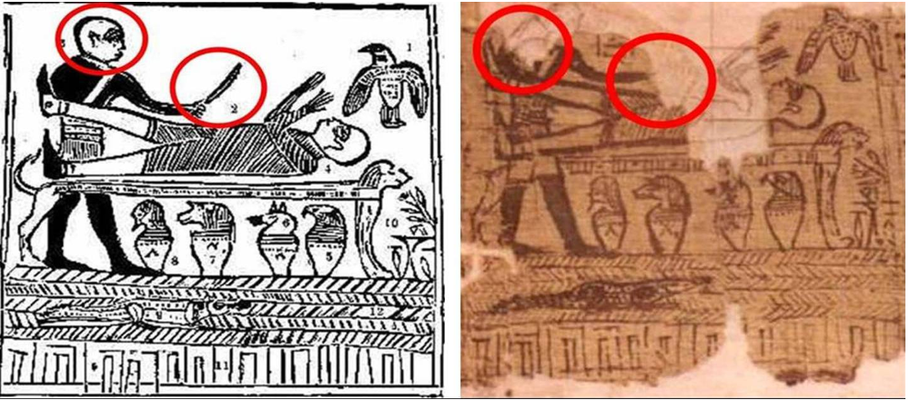
In 1966 at the New York Metropolitan Museum of Art, Smith's papyrus fascimilie was compared to the original.
The Mormon Church validated the authenticy.
However, the ability to read Egyptian texts did not exist when Smith did his "translation“.

Slide 19
Proof in the Pudding
Upon assessment from Egyptologists:
The papyri were Egyptian burial texts and had nothing to do with Abraham or Joseph from the Bible.
The golden plates that Smith said he copied from were said to be taken up to heaven, so we can’t corroborate those.
Smith evidentially made a complete fabrication of the papyri text.

Slide 20
False Prophecies
Joseph Smith prophesied that his work would be finished before he died; he did not finish the Pearl of Great Price book before, which is supposed to be divine revelation.
He said Jesus would come back in their lifetime to judge the entire earth
He said they would build a temple in Jacksonville, Missouri which never happened.

Slide 21
False doctrines
Mormonism teaches that there are a bunch of little "g" gods who are made by previous gods.
Man is progressively becoming a god.
It is necessary to provide parentage for the spirit children of God who were ready and waiting for the experience of eternal life.
Eternal life is obtained for men by becoming a Mormon priest. For women, they must marry a Mormon priest.

Slide 22
Judaism
Without the Temple and the Altar, which were destroyed in 70 A.D., the Jews are without a way to make atonement for their sins (Leviticus 17:11).

Slide 23
Missed opportunities
Jews no longer celebrate festivals that are required in the law of Moses (i.e. Festival of First Fruits, Jubilee Festival and Sabbatical Year).
In Jewish religious practice, overwhelmingly the majority of Jews are secular, only a small minority are religious.
Non-Christian Jews still reject Jesus as their Messiah

Slide 24
Rabbinic Judaism dominates
Rabinic teachings are put above the previous revelation of God,
following "the commandments of men"
While Jews in rabbinic Judaism
appear to honor the Christian God,
in practice,
they deny and mock His authority
by contradicting previous revelation
and not accepting their Messiah

Slide 25
Rabinnic Judaism
Rejects the clear sign from Yahweh
that the old covenant was ended
with the AD 70 temple destruction,
starting the Church age
with the new covenant

Slide 26
Isaiah 52 + 53
The "suffering servant" matches no one else but Jesus
Israel was not "crushed for our iniquities"
or
"pierced for our transgressions"
or
"bore the sin of many"
Or
"interceded for the transgressors"

Slide 27

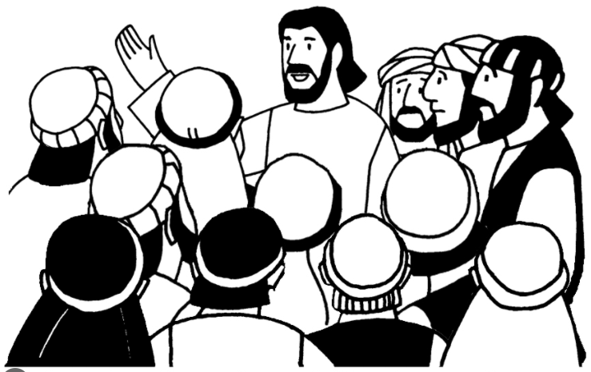
Notice
How all these other monotheistic religions
which ape Christianity
Are started by one man
Who gets tons of benefits
and grossly immoral
Compare that with the complete opposite
with Jesus
and His apostles

Slide 28

Non-Christian monotheism
is unable to be the source of logic
if the religion itself
disqualifies itself
with internal self-contradictions

Slide 29


Next Module:
Spicing things up with
a whole swath of
objections to the
Christian worldview

Slide 30

End of Module 9
Questions?

